Slide 1



TEAM CASTLE CEC 2024
Kevin Manka James Su David Tam Collin Town

Slide 2

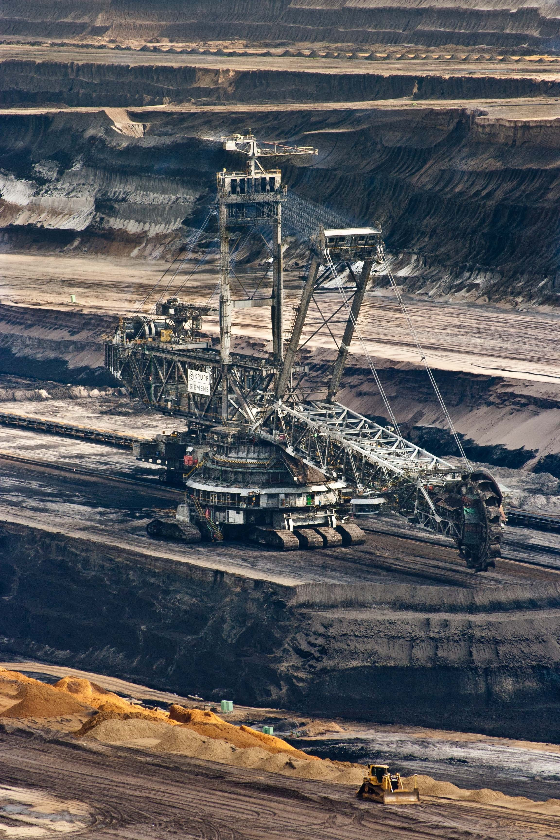
1 Overview
What does it mean to preserve?
A growing population, a growing need for resources
Silver was undersupplied by 237 million ounces in 2023 alone
How can sustainability be ensured?
1
1 Mills, R. (2023, December 26). Will 2024 be the year for precious metals? Mining.com.
TEAM CASTLE CEC 2024
Kevin Manka James Su David Tam Collin Town

Slide 3
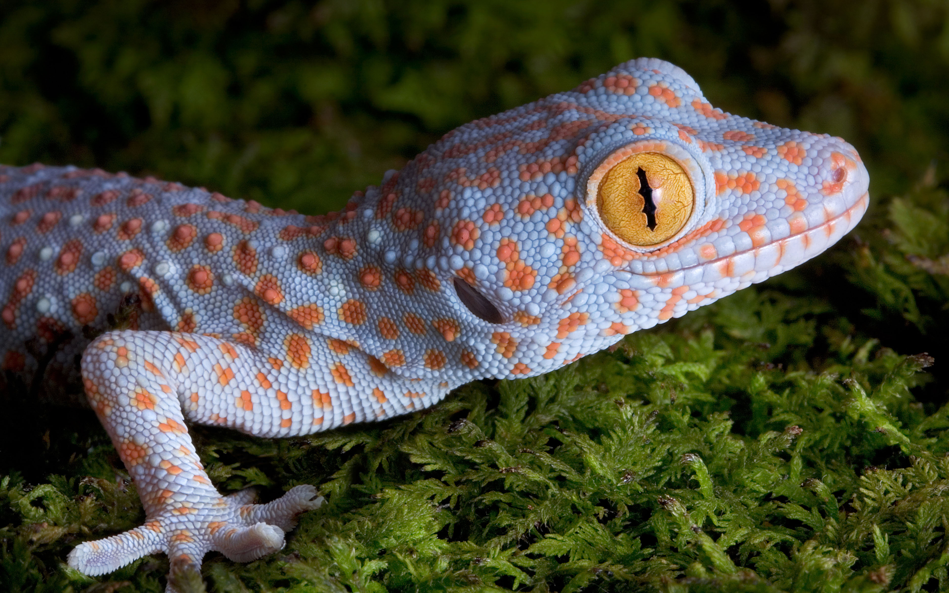
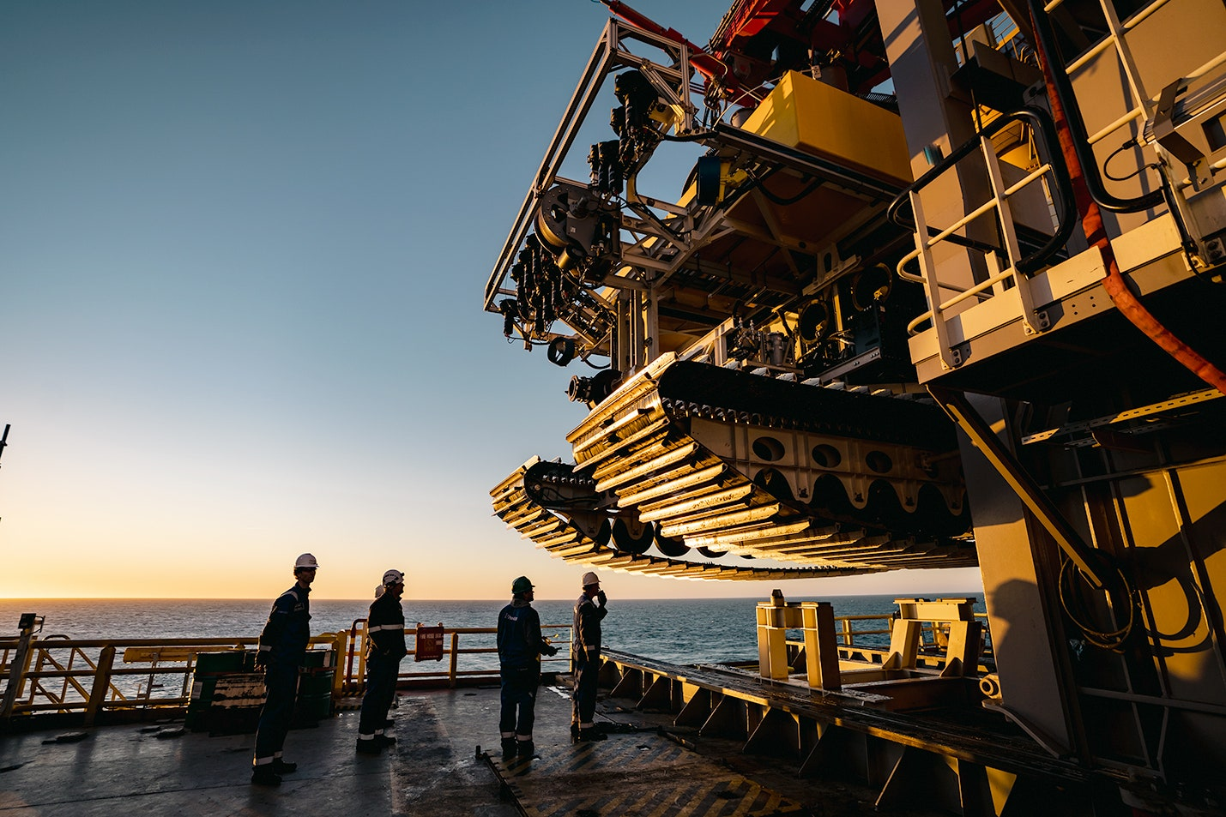
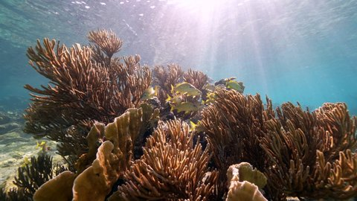
2 Proposed Solution
Web application that informs sustainable resource acquisition in F.I.N.
Delineates an optimal route for minimally-invasive coastal activity
TEAM CASTLE CEC 2024
Kevin Manka James Su David Tam Collin Town

Slide 4




3 Technology Stack
+
+
+
Vite
React
TypeScript
Python
TEAM CASTLE CEC 2024
Kevin Manka James Su David Tam Collin Town

Slide 5
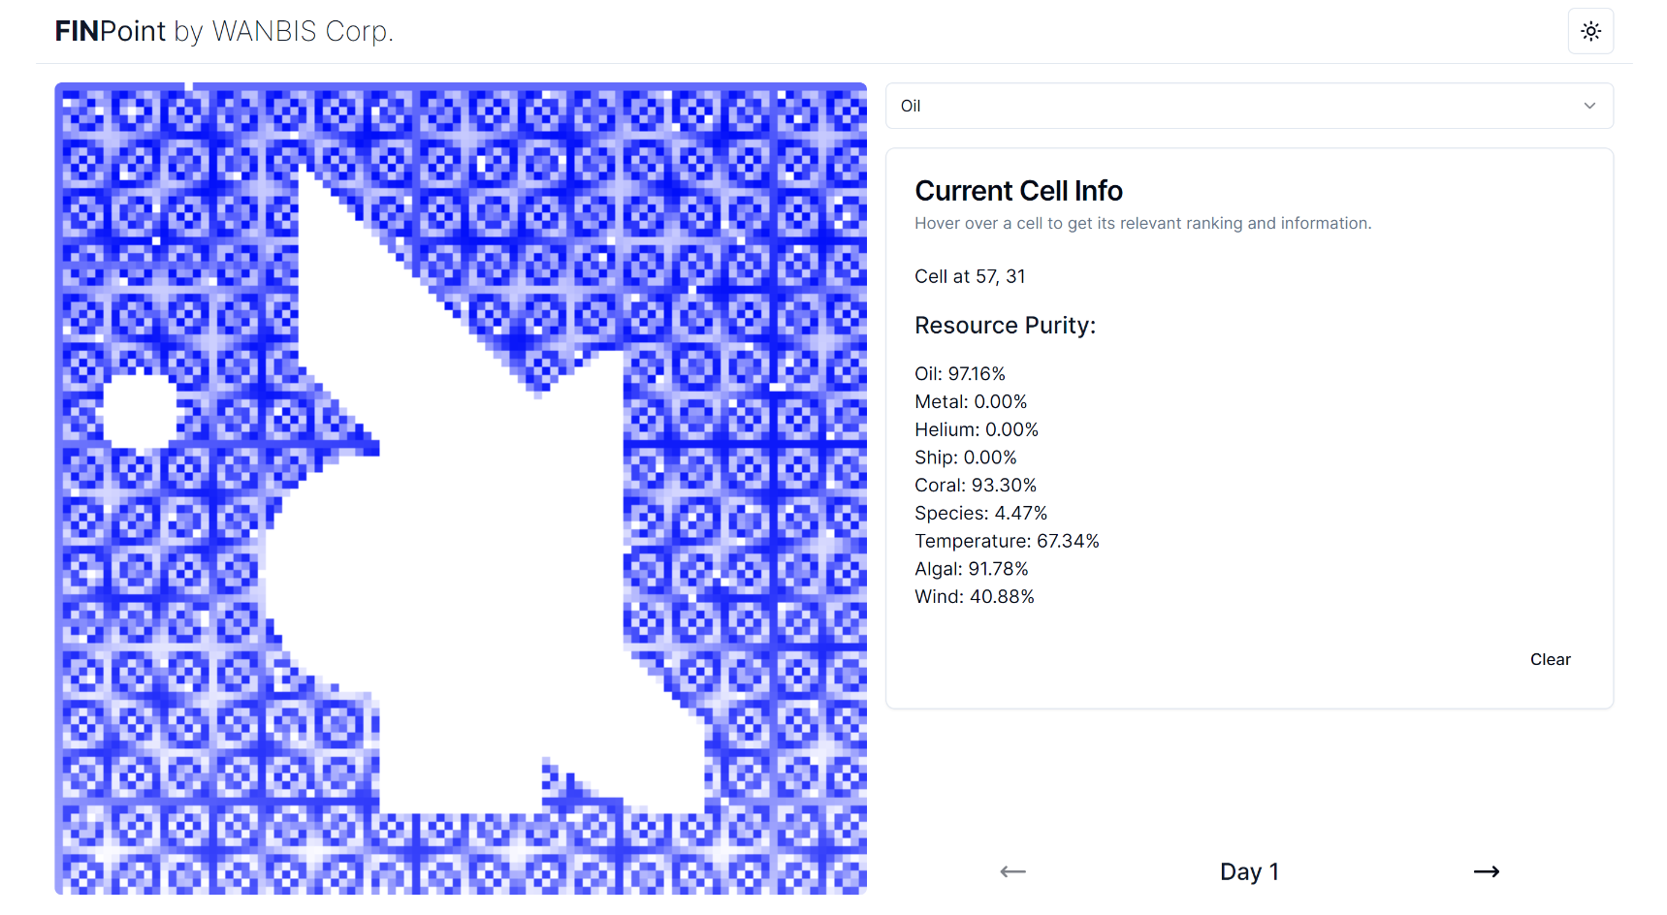
4 Interface Design & Implementation
3
View optimal drilling routes over 30 days
Click on individual coordinates to reveal local resource valuations
Access visualizations of any resource
2
1
TEAM CASTLE CEC 2024
Kevin Manka James Su David Tam Collin Town

Slide 6


5 Algorithm Design & Implementation
K-means Clustering algorithm
36 Clusters
38 Clusters
TEAM CASTLE CEC 2024
Kevin Manka James Su David Tam Collin Town

Slide 7
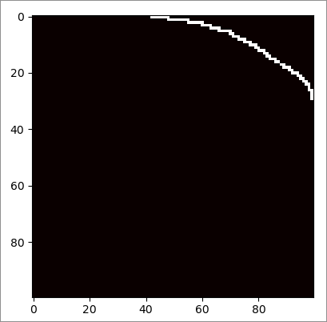
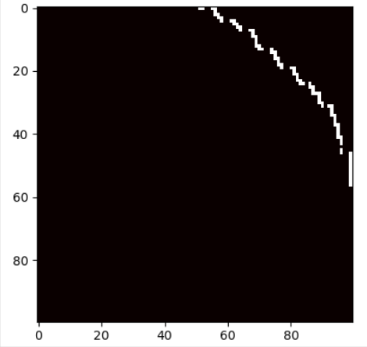
5 Algorithm Design & Implementation
Path 1
Path 2
TEAM CASTLE CEC 2024
Kevin Manka James Su David Tam Collin Town

Slide 8
6 Demonstration
TEAM CASTLE CEC 2024
Kevin Manka James Su David Tam Collin Town

Slide 9
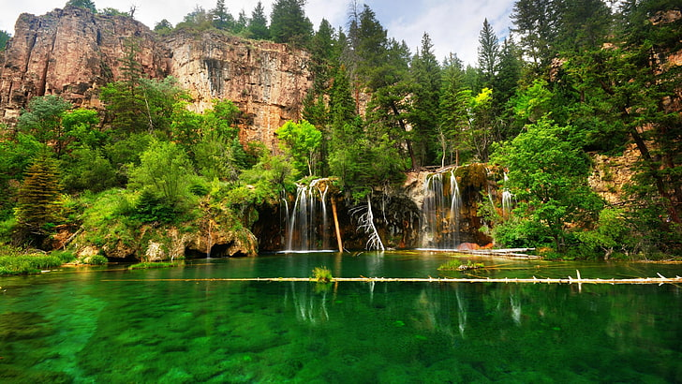
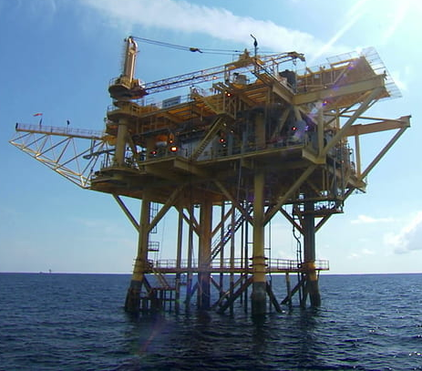
7 Final Remarks
FINPoint is easily malleable to change
Accounts for all desirable and protected resources
Bridging innovation with sustainability
TEAM CASTLE CEC 2024
Kevin Manka James Su David Tam Collin Town

Slide 10
TEAM CASTLE CEC 2024
Kevin Manka James Su David Tam Collin Town

